Slide 1


CAPSTONE PROJECT
Student performance Data set
Presented By:
1. M. Balaji-Solamalai College of Engineering-Mechanical Engineering

Slide 2
OUTLINE
○
Probelm Statement
Proposed Solution
System Approach
Algorithm & Deployment
Result
Conclusion
Future Scope
References
○ ○ ○ ○
○
○ ○

Slide 3
PROBLEM STATEMENT
Data Collection: Implement a mechanism to collect student performance data including grades, attendance records, demographic information, and any other relevant metrics.Data Storage: Create a database or data warehouse to store the collected data securely.

Slide 4
PROPOSED SOLUTION
Data Collection and Storage:Implement an automated data collection system that gathers student performance data from various sources such as academic records, attendance databases, and demographic surveys.Store the collected data securely in a relational database or data warehouse with appropriate access controls and encryption measures to ensure data integrity and confidentiality.Data Analysis:Utilize machine learning algorithms for analyzing student performance data, including regression analysis, classification algorithms, and clustering techniques.Develop models to predict student performance based on historical data, identify factors influencing academic outcomes, and detect patterns indicative of at-risk students.

Slide 5
SYSTEM APPROACH
Building the proposed solution would involve a combination of data processing,feature engineering,and machine learning. Here are the key system and library requriements.
System Requirements:
1.Hardaware:
A computer with sufficent processing power,perferably wwith multiple cores or a GPU for faster traning of machine learning models.
Adequate RAm to handke the size of the saraset and computational requriments.
2. Software:
An operating syatem compatible with the requrired machine learning libraries(eg., Windowa=s, linux,macsOS).

Slide 6
ALGORITHM & DEPLOYMENT
Data Preprocessing:Clean the collected data by handling missing values, outliers, and inconsistencies.Encode categorical variables and normalize numerical features to prepare the data for analysis.Feature Engineering:Extract relevant features from the data such as attendance rates, socio-economic indicators, and performance in specific subjects.Create additional features if necessary, such as cumulative GPA or standardized test scores.

Slide 7
ALGORITHM & DEPLOYMENT
Deep neural networks (DNN)
Deep neural networks (DNN) is a class of machine learning algorithms similar to the artificial neural network and aims to mimic the information processing of the brain.
Steps to implement the DNN algorithm:
Data collection
Feature extraction
Information processing
Model training
Performance evaluation

Slide 8
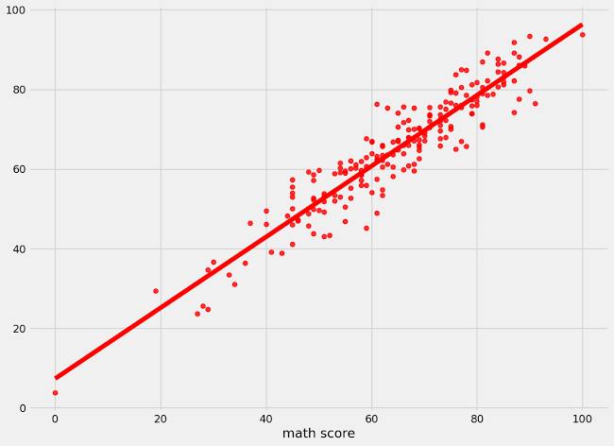
RESULT

Slide 9
CONCLUSION
This work is based on the Ultimaker S5 3-D printer settings and filaments. Material and strength tests were carried out on a Sincotec GMBH tester capable of pulling 20 kN.
Here we try to estimate which material is used from the input and output parameters using the kNN and DNN algorithms.

Slide 10
FUTURE SCOPE
The future of 3D printing is bright, promising faster, more diverse, and more integrated production methods. By embracing these trends and prioritizing quality, security, and sustainability, this technology can revolutionize manufacturing and empower businesses to create a more resilient and responsible future.

Slide 11
REFERENCES
https://www.kaggle.com/datasets/afumetto/3dprinter

Slide 12
THANK YOU

